Slide 1
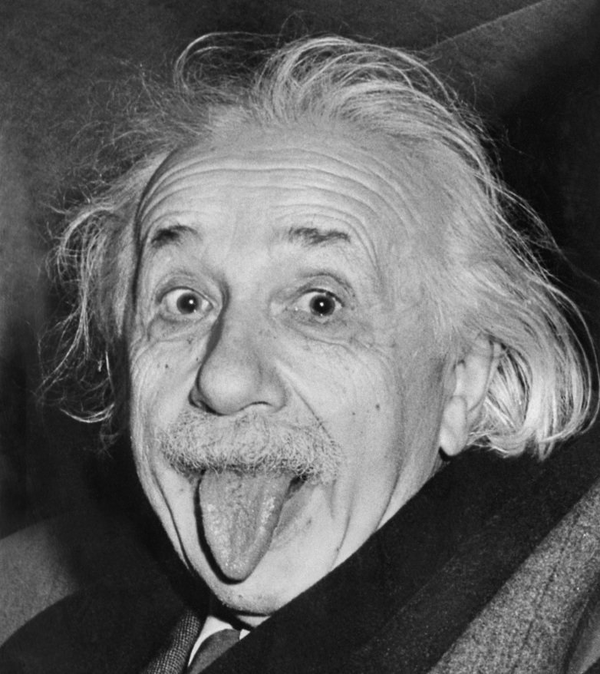
The Data Scientist The Hacker Scientist
Machine Learning
Statistics
Programming/Hacking
Communication
Domain knowledge

Slide 2
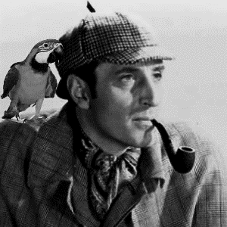
The Data Scientist The Detective
Analytical rigor
Skepticism
Curiosity
Creative thinking
Intuition

Slide 3
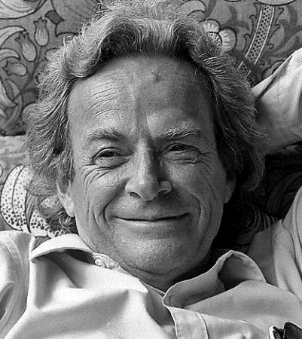
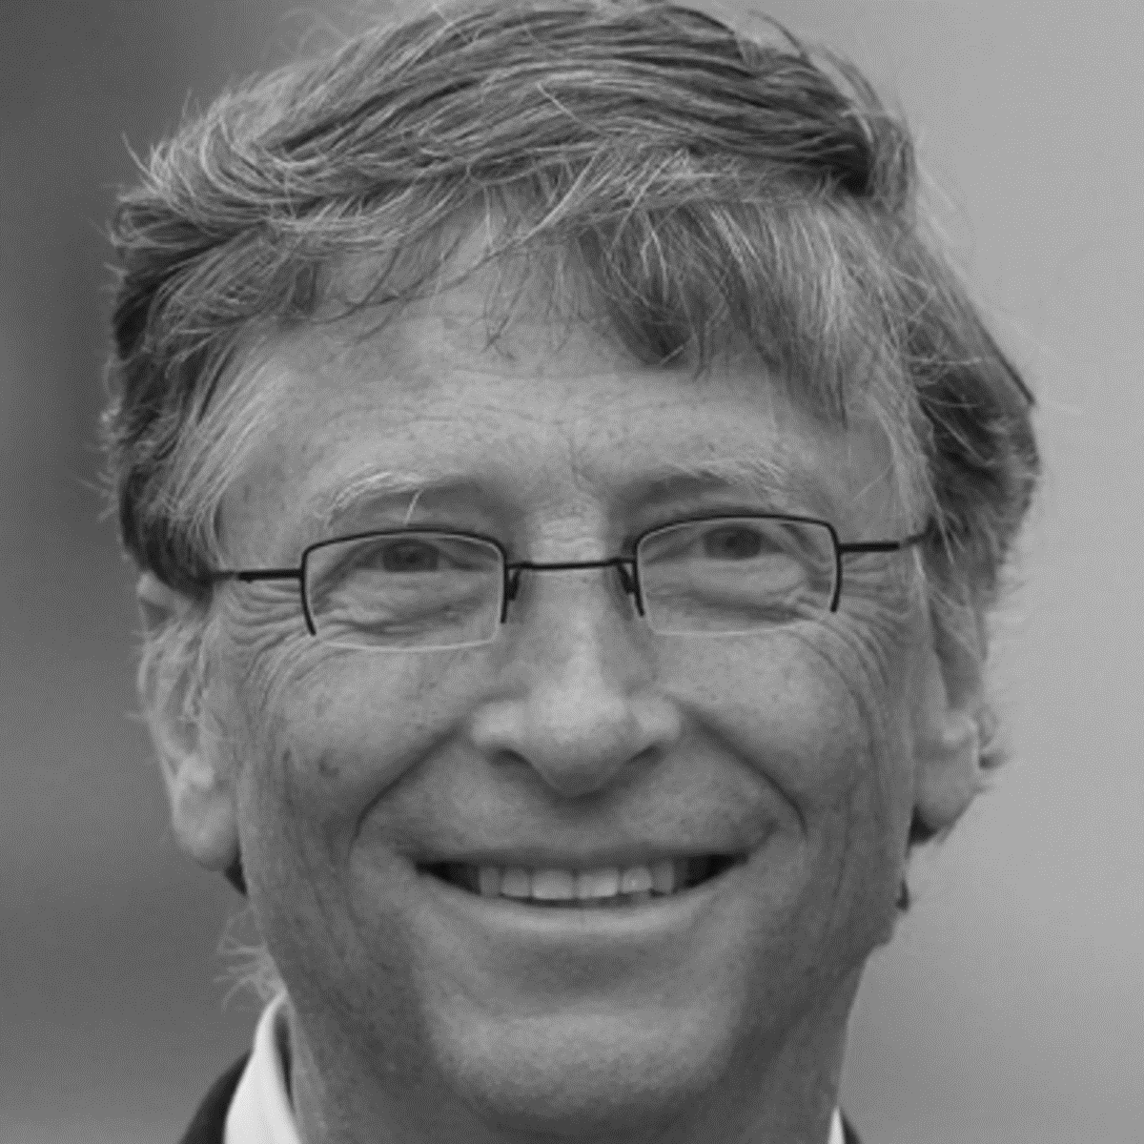
Great Data Scientists
Albert Einstein
“Imagination is more important than knowledge”
Richard Feynman
- The joy of finding things out
- Feynman Diagrams
Hercule Poirot
“Use your little grey cells mon ami"
Bill Gates Data driven approach to philanthropy

